Slide 1


Loan Eligibility Predictor
By Group 9

Slide 2

Outline
BRIEF ABOUT LOAN PREDICTOR
WHY WE NEED IT?
About the data set
machine learning process
Model Evaluation
Model's Predictions
Test Case

Slide 3

What is loan Eligibility predictor ?
A LOAN PREDICTOR IS A COMPUTER TOOL THAT DECIDES IF SOMEONE CAN GET A LOAN OR NOT BASED ON THEIR FINANCIAL DETAILS.
IT LOOKS AT A BUNCH OF INFORMATION ABOUT THE PERSON, LIKE THEIR INCOME, CREDIT HISTORY, AND OTHER STUFF, AND THEN GIVES A YES OR NO ANSWER

Slide 4

WHY WE NEED IT?
WE NEED A LOAN PREDICTOR FOR-
EFFICIENT ASSESSMENT OF LOAN ELIGIBILITY.
HELPING BANKS IN MAKING MORE INFORMED DECISIONS.
REDUCE PAPERWORK.
OFFER LOANS MORE FAIRLY AND PROMPTLY TO QUALIFIED APPLICANTS.

Slide 5


LET’S ANALYSE THE DATASET

Slide 6
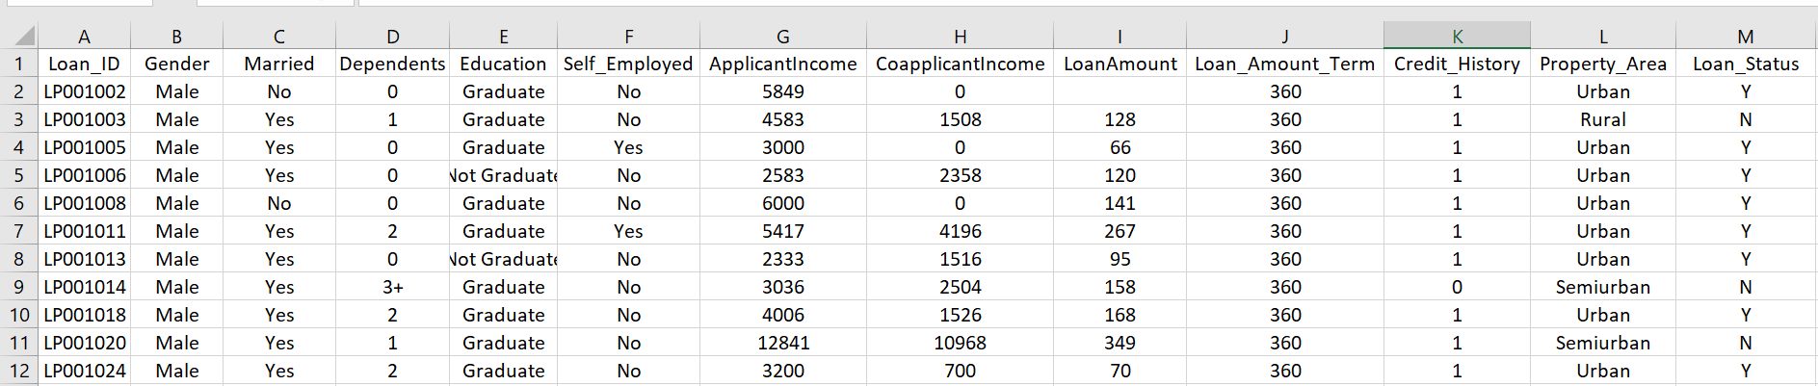

DATASET ANALYSIS(PROBLEM ANALYSIS)
THE DATASET USED FOR THIS PROJECT CONSISTS OF VARIOUS FINANCIAL AND PERSONAL ATTRIBUTES OF LOAN APPLICANTS, SUCH AS INCOME, EDUCATION STATUS, EMPLOYMENT STATUS, AND LOAN STATUS (APPROVED OR DENIED).

Slide 7

MACHINE LEARNING PROCESS
Now comes the process modeling after we thoroughly analysed the dataset. Here are the key steps in machine learning modeling:
Data Collection
Importing of libraries & creating Dataframe
Data Preprocessing
Handeling of Nulls
Handeling Outliers
Data Splitting
Feature Scaling
Model Selection, Training & Evaluation

Slide 8
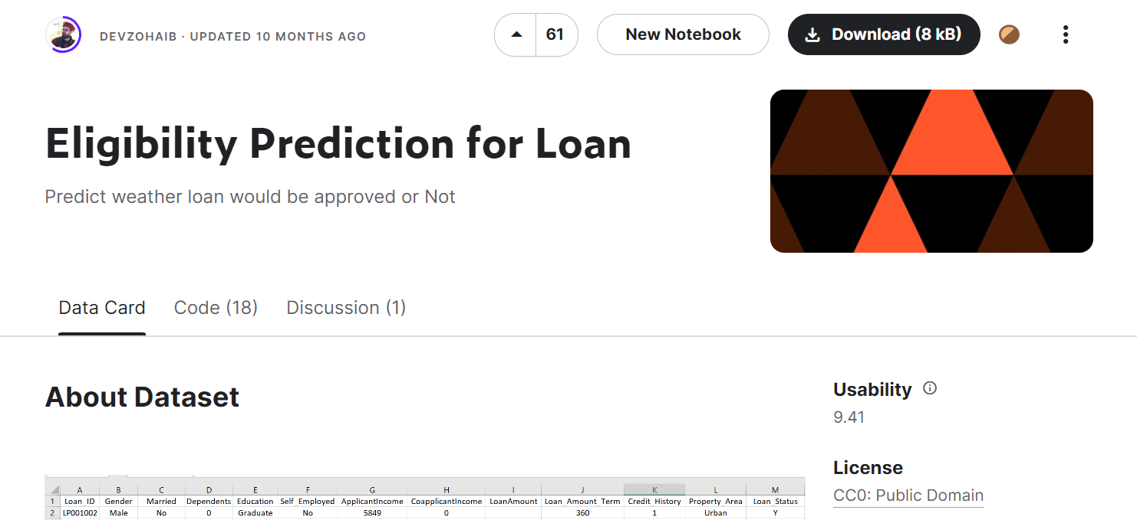
DATA COLLECTION
08
We start by gathering information from sources like surveys, databases, or even the internet.
Here we got out dataset from kaggle

Slide 9
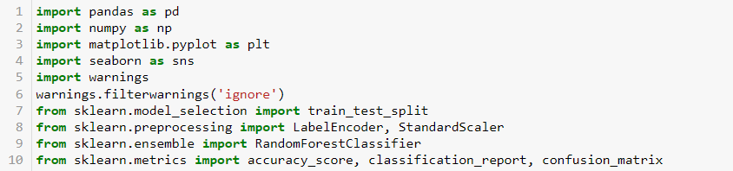
IMPORTING OF LIBRARIES & CREATING DATAFRAME
We need to import a whole lot of libraries and the dataset as well for creating a dataframe

Slide 10
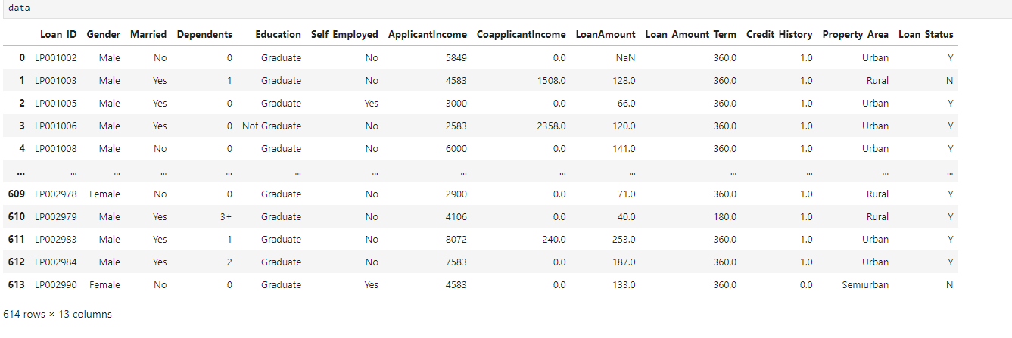
DATA PREPROCESSING
We clean and organize the data.This involves handling missing values, converting data types, and scaling numerical values. We ensure the data is ready for analysis .
The current dataframe looks like-

Slide 11
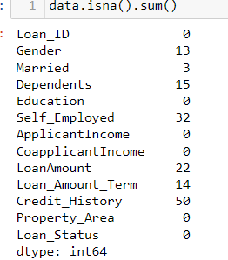
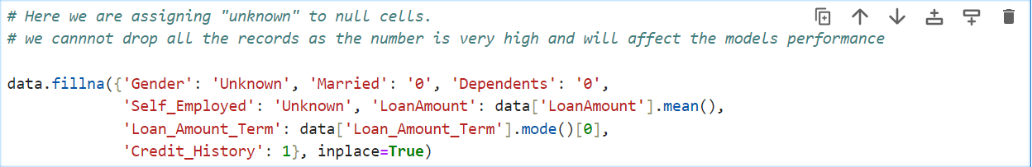
HANDLING OF NULLS
We need to handle the null values present in the cells .
This can be done by-

Slide 12
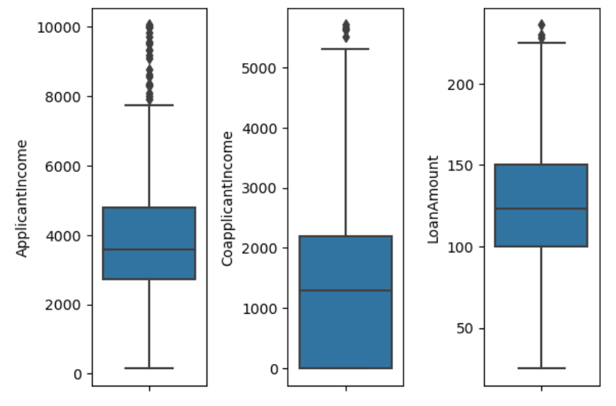
HANDELING OUTLIERS
Here, we remove the outliers the feature gets limited between 10000
Hence the outliers are removed:

Slide 13
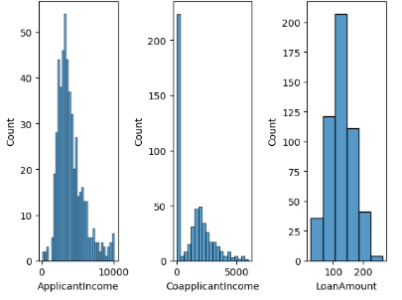
VISUALIZATION OF DATA
Here we have arrange the ‘ApplicantIncome’ , ‘CoApplicantIncome’ and ‘LoanAmount’ in a histogram insight

Slide 14
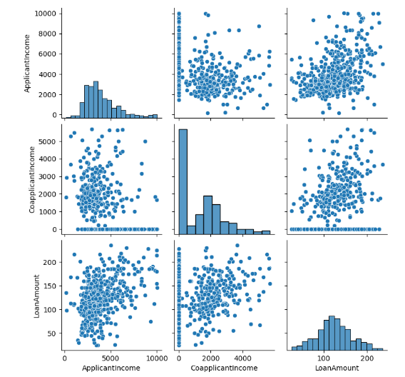
SOME VALUABLE INSIGHTS
The pair plot highlights that while there is a moderate correlation between ‘ApplicantIncome’ and ‘LoanAmount’, the relationship is not very strong, as indicated by the scatter plot.
The distributions show that most applicants and co-applicants have lower incomes, and most loans are for smaller amounts.

Slide 15
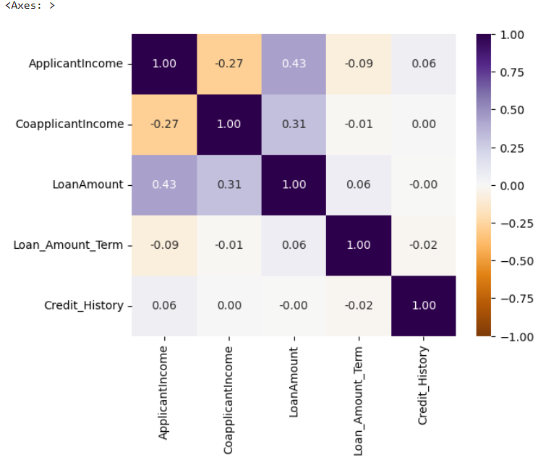
DENSITY MAP
The heatmap reveals that ApplicantIncome and LoanAmount have a moderate positive correlation (0.43), indicating that higher applicant incomes are somewhat associated with higher loan amounts. CoapplicantIncome also shows a weaker positive correlation with LoanAmount (0.31).
This insight can guide further analysis, particularly in feature selection for predictive modeling.

Slide 16
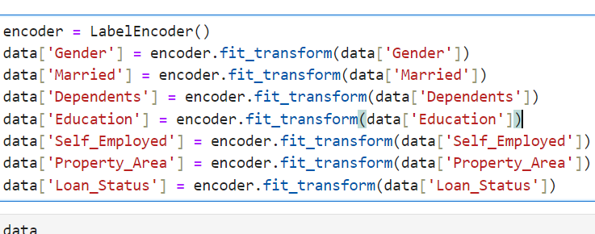
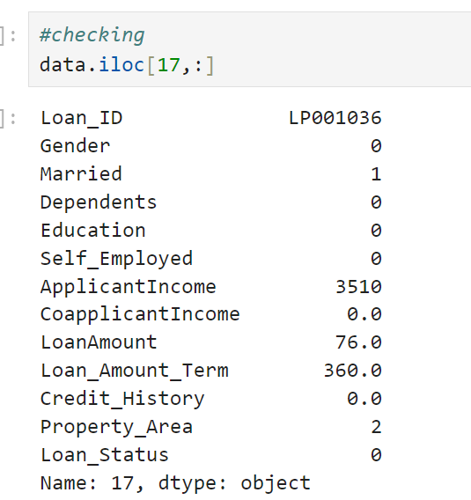
ENCODING OF CATEGORICAL DATA
We need to handle the null values present in the cells .
This can be done by-

Slide 17
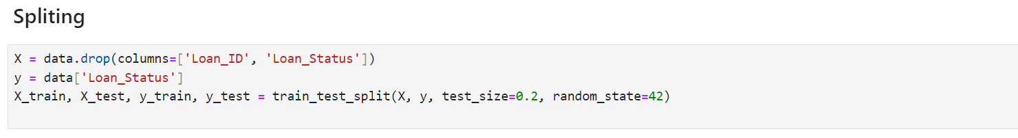
DATA SPLITTING
We need to do Data Spliting to:
Separates data for model evaluation.
Prevents overfitting.

Slide 18
MODEL SELECTION
We need to perform model selection for:
Choosing a model is like picking the right tool for a job.
We select a machine learning algorithm that best suits our problem (e.g., decision trees for choices, linear regression for trends).
Just as you'd use a hammer for nails and a screwdriver for screws, we match the model to the problem for the best results.
We need to analyse the data and look for insights for selecting best model and sometimes it can be trial dependent
The better the model selection the better the predictions .

Slide 19
WHY RANDOM FOREST ?
We opted for Random Forest Classification in our Loan Eligibility Predictor because it's like having a team of decision-makers (trees) that work together to provide accurate loan predictions, making our model more reliable and robust and its efficiency was better than logistic regression.
Notes:
Each decision tree is like an expert, providing its opinion on how to classify the data. Predictions are made by calculating the prediction for each decision tree, then taking the most popular result

Slide 20
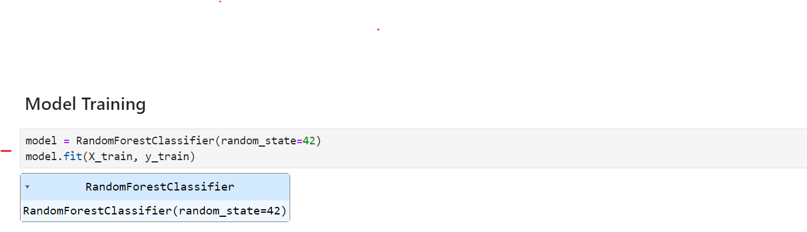
MODEL TRAINING
We need to do Model Training in order to:
Recognize patterns and generalize.
Optimizes parameters for better performance.
Enables accurate predictions and classifications.
Facilitates continuous learning and adaptation.

Slide 21
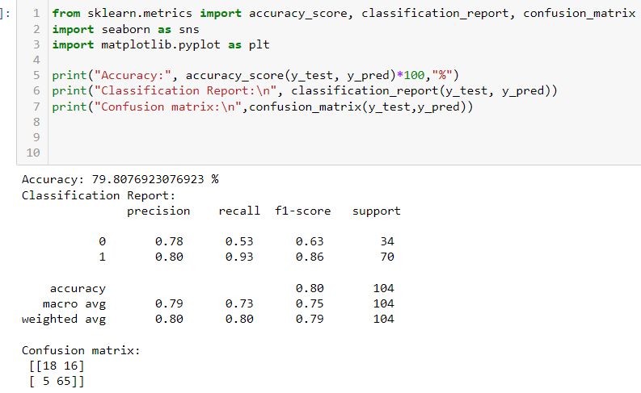
MODEL EVALUATION
We need Model evaluation in order to:
Evaluates generalization.
Assesses accuracy and overfitting.
Compares models for task suitability.
Validates reliability for real-world deployment.
Metrics like accuracy, precision, recall guide evaluation

Slide 22
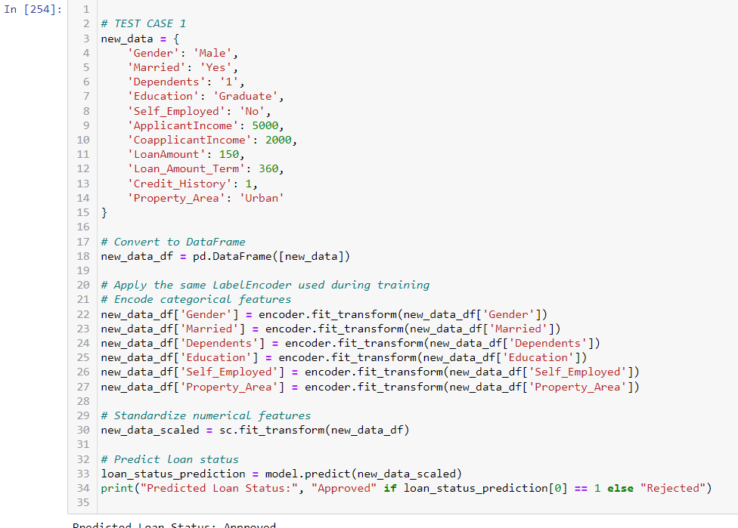
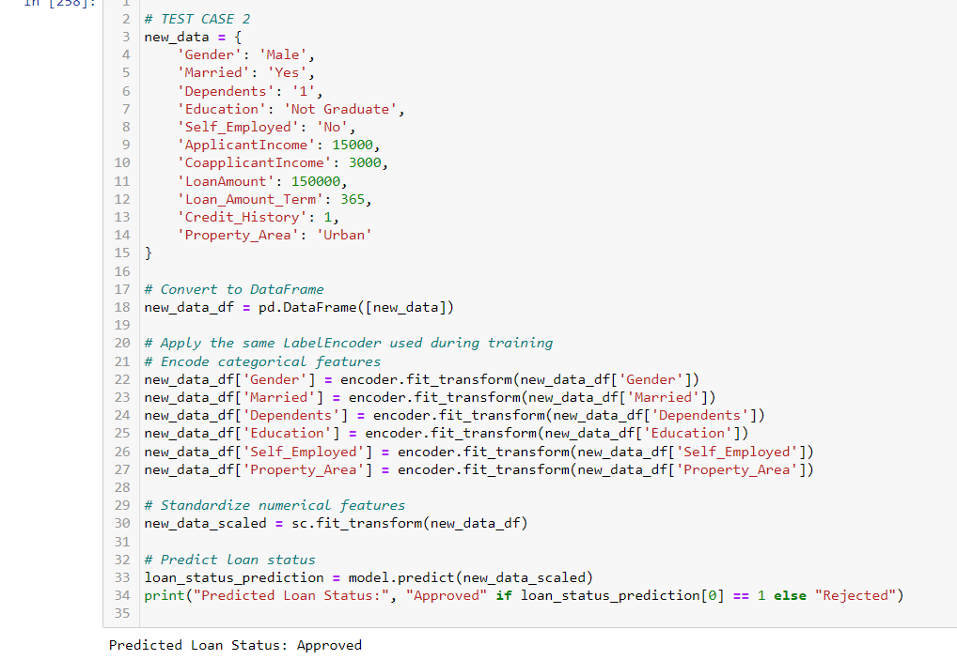
TEST CASES

Slide 23

Presented by
Aryan Pandey
Arjit Srivastava Aditya Gupta

